Slide 1
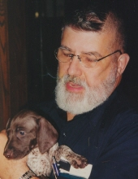
Floyd Garth Willoughby
January 8, 1944 - July 8, 2014

Slide 2
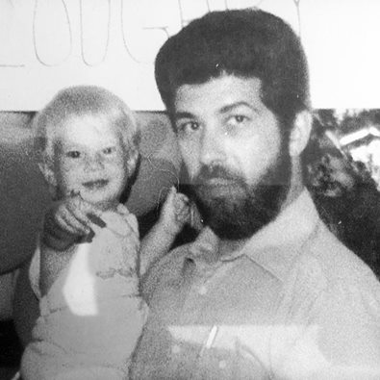
I will always be grateful for the help Floyd provided when I moved into the faculty subdivision. The house I was renting had bad electrical outlets, a backyard full of ground wasps, and the general condition of the house was poor. Floyd brought the children over to help paint the walls. He replaced the bad (and dangerous) outlets and destroyed the wasp nests. This act of kindness was most appreciated and has not been forgotten. It was a pleasure to work with him in the School of Business Administration and to have him as a neighbor. I wish to express my condolences to his family during this difficult time. - Sheryl Clark Klemanski
Dr. Willoughby was a great instructor in my graduate work and a wonderful mentor in my efforts as an adjunct at OU. He has been and will continue to be honored in my opening lecture of every MGT110 course that I instruct. I am eternally grateful, Sir. Arthur Galvan

Slide 3
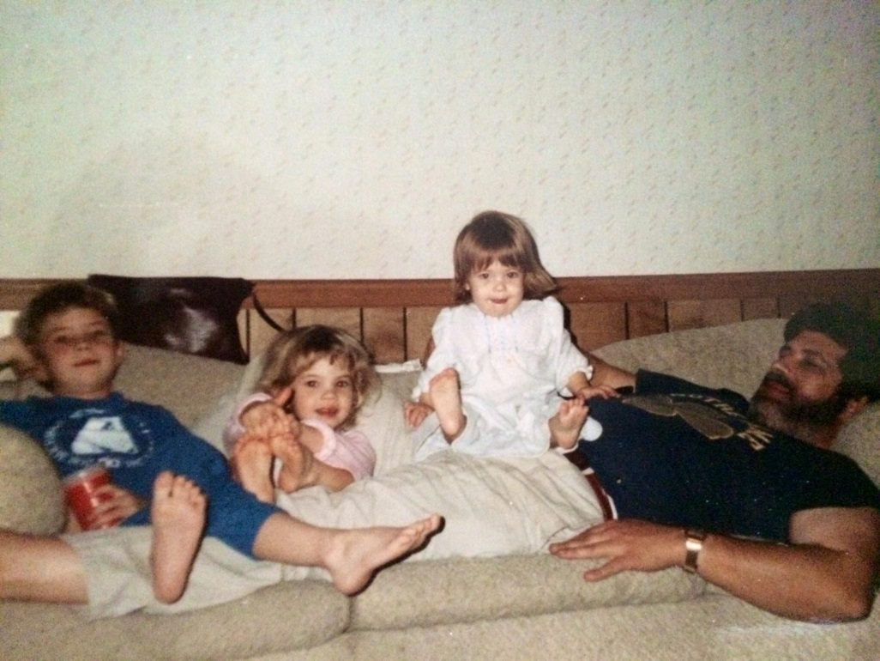
Dear Dad, It will be a privilege to attend your memorial service, but hard to say goodbye. I am sorry I was unable to see you one last time as my last visit was too long ago. I shall try and avoid regret, but rather be thankful for the memories. It is hard to accept you are gone but I take comfort in knowing you are at peace and you will look over your children. Love Garth

Slide 4
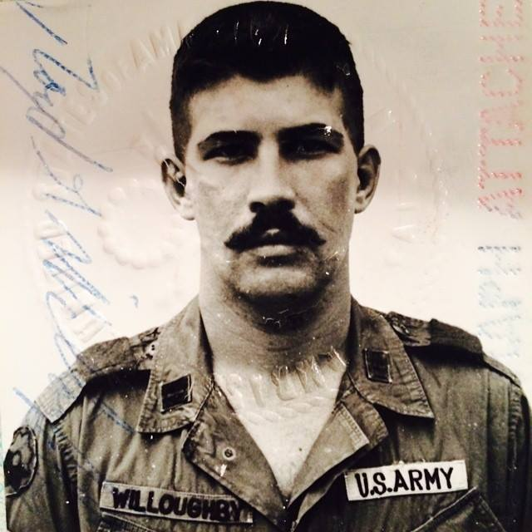
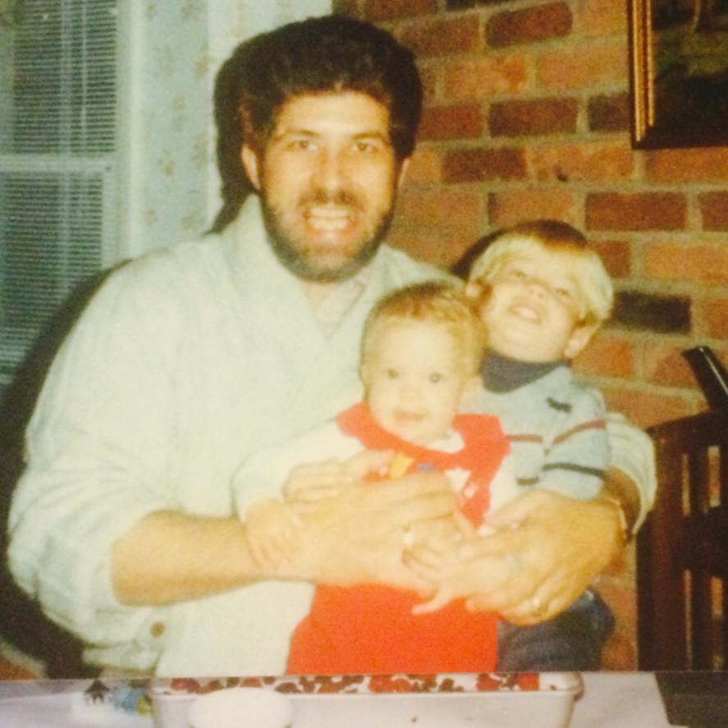
I will always remember you as an honest man. - Daniel Ring

